Slide 1
Testing of Hypothesis

Slide 2
Hypothesis Testing
A statistical hypothesis is an assertion or conjecture concerning one or more populations.

Slide 3
The Null and Alternative Hypotheses
Null hypothesis, which refers to any hypothesis we wish to test and is denoted by H0. The rejection of H0 leads to the acceptance of an alternative hypothesis, denoted by H1.

Slide 4
Test Statistic
The rule or formula.

Slide 5
Approach to Hypothesis Testing with Fixed Probability
State the null and alternative hypotheses.
Choose a fixed significance level α.
Establish critical region based on α.
Choose an appropriate test statistic.
Perform computation.
Reject H0 if the computed test statistic is in the critical region. Otherwise, do not reject.

Slide 6
Single Sample: Tests Concerning a Single Mean

Slide 7
Tests on a Single Mean (Population Variance Known)

Slide 8



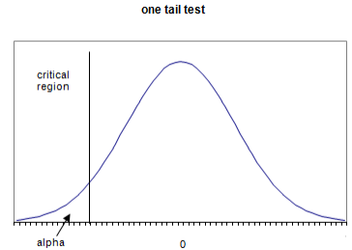
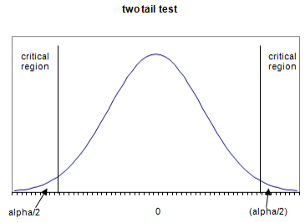
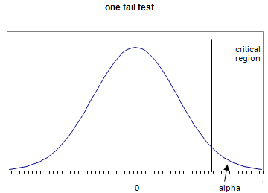

Tests on a Single Mean (Population Variance known )
Reject H0 if the computed test statistic is in the critical region. Otherwise, do not reject.

Slide 9
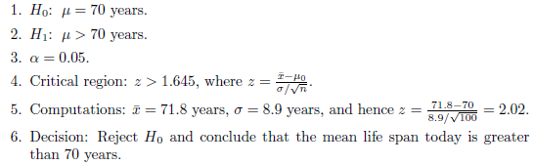
Example: A random sample of 100 recorded deaths in the United States during the past year showed an average life span of 71.8 years. Assuming a population standard deviation of 8.9 years, does this seem to indicate that the mean life span today is greater than 70 years? Use a 0.05 level of significance.
Solution:

Slide 10
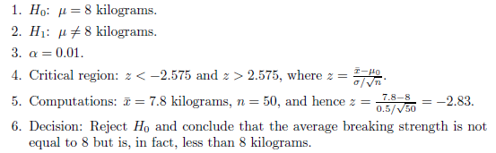
Example: A manufacturer of sports equipment has developed a new synthetic fishing line that the company claims has a mean breaking strength of 8 kilograms with a standard deviation of 0.5 kilogram. Test the hypothesis that μ = 8 kilograms against the alternative that μ ≠ 8 kilograms if a random sample of 50 lines is tested and found to have a mean breaking strength of 7.8 kilograms. Use a 0.01 level of significance.
Solution:

Slide 11
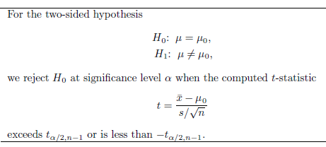
The t-Statistic for a Test on a Single Mean (Population Variance Unknown)
For H1: μ > μ0, rejection results when t > tα,n−1.
For H1: μ < μ0, the critical region is given by t <−tα,n−1.

Slide 12
Tests on a Single Mean (Population Variance unknown and n<30)

Slide 13


Tests on a Single Mean (Population Variance unknown and n<30)
Reject H0 if the computed test statistic is in the critical region. Otherwise, do not reject.

Slide 14
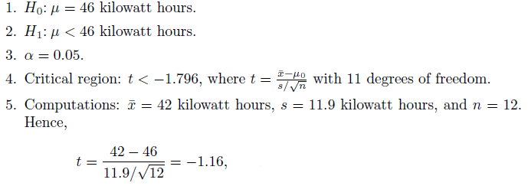

Example: The Edison Electric Institute has published figures on the number of kilowatt hours used annually by various home appliances. It is claimed that a vacuum cleaner uses an average of 46 kilowatt hours per year. If a random sample of 12 homes included in a planned study indicates that vacuum cleaners use an average of 42 kilowatt hours per year with a standard deviation of 11.9 kilowatt hours, does this suggest at the 0.05 level of significance that vacuum cleaners use, on average, less than 46 kilowatt hours annually? Assume the population of kilowatt hours to be normal.
Solution:

Slide 15
Tests on a Single Mean (Population Variance unknown and n≥30)

Slide 16

Tests on a Single Mean (Population Variance unknown and n≥30)
Reject H0 if the computed test statistic is in the critical region. Otherwise, do not reject.

Slide 17
Assignment
10.19
10.20
10.21
10.22
10.23
10.24
10.25
10.26

